Slide 1
Bluetooth Protocol Stack

Slide 2
Bluetooth Protocol
The Bluetooth stack protocol refers to the software architecture and layers responsible for managing Bluetooth communication between devices.
Used To implement a personal area network.
Enables various Bluetooth functionalities, such as data transfer, device discovery, pairing, and communication between different types of devices.

Slide 3
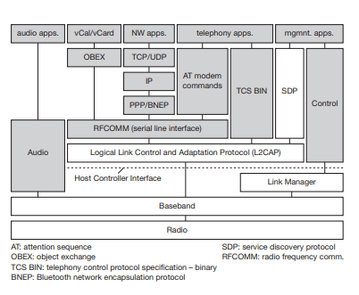
Protocol Architecture

Slide 4
Physical Layer: This layer deals with the actual transmission of data over the air using radio frequencies. It handles tasks such as modulation, frequency hopping, and power control.
Link Layer: The link layer manages the establishment, maintenance, and termination of connections between Bluetooth devices. It handles tasks such as device discovery, pairing, authentication, encryption, and packet framing.
Logical Link Control and Adaptation Protocol (L2CAP): L2CAP is responsible for multiplexing higher-level protocols and segmenting large packets into smaller ones for transmission. It also provides error detection and retransmission capabilities.
Host Controller Interface (HCI): HCI serves as the interface between the Bluetooth hardware and the higher layers of the protocol stack. It allows higher-layer protocols to control the Bluetooth radio hardware and access various functionalities provided by the Bluetooth controller.
Service Discovery Protocol (SDP): SDP allows Bluetooth devices to discover and advertise the services they offer. It enables devices to understand each other's capabilities and establish connections for specific services.
RFCOMM: RFCOMM emulates serial port communication over Bluetooth, allowing legacy applications designed for serial ports to communicate over Bluetooth connections.
Bluetooth Network Encapsulation Protocol (BNEP): BNEP provides a way to transmit network-layer protocols (such as IP) over Bluetooth connections. It allows Bluetooth devices to form ad-hoc networks and share network resources.
Object Exchange (OBEX): OBEX facilitates the exchange of objects (such as files, contact cards, and calendar events) between Bluetooth devices. It defines a set of common protocols and formats for object exchange.

